Slide 1
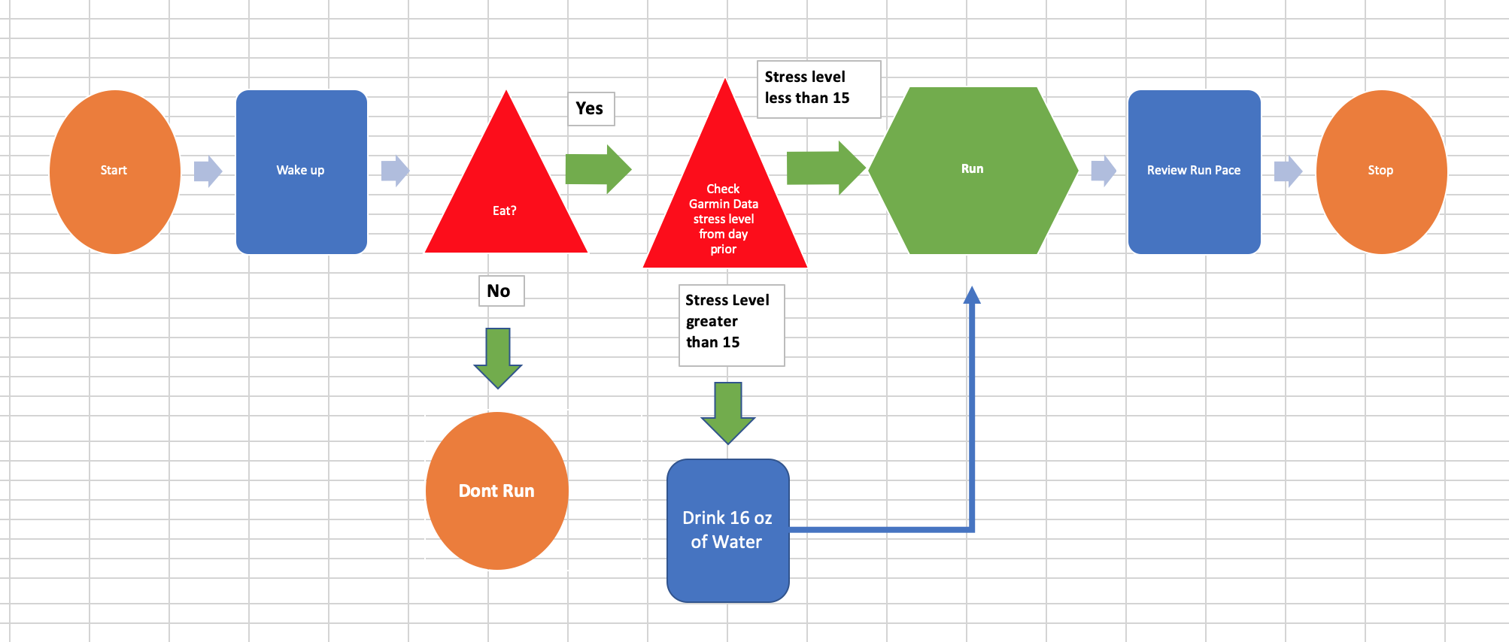
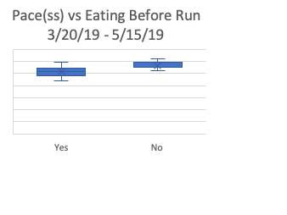
Measuring to Understand & Improve Contract Bids Between Homeowners & Construction Business
Process Owner:
Define
4/11/19
Measure
4/11/19
Control
Ongoing
Improve
5/17/19
Analyze
5/15/19
Problem: Runner is running too slow. Despite running consistently for two years, speed does not improve
Goal: consistently run first mile of every run at 8:15 pace (495 seconds) or less.
Measurement of 4 inputs that possibly contribute to successful run:
Estimated Stress Level day prior to run computer by Garmin
Hours of sleep night prior
Low body weight
Nutrition before run
*All measurements collected through Garmin watch data & running journal
New Process Map to ensure food intake and proactivity in lowering stress value
Not eating linked to slower pace as well as Garmin Stress Levels
NEW SQL: 1.7
Measures of Variability after Improvement Process:
New Mean =497 seconds
New Sample mean for pace only 2 seconds away from goal of 495 seconds or less after new process!
Hours of Sleep
Weigh
Eat before
Y/N
Run < 8:15 Y/N
Stress Level Day Prior
SQL: 0.3
~ CONTROL ~
Continue to eat and reduce stress level
Add new improvement by measuring run time of day and speed training
Daily Weight and Hours of Sleep not strong indicators of daily pace
Mean pace 3/20-5/15 = 541ss or 9:01 pace
~ TEAM ~
Waylon Abernathy, Project Owner

Slide 2
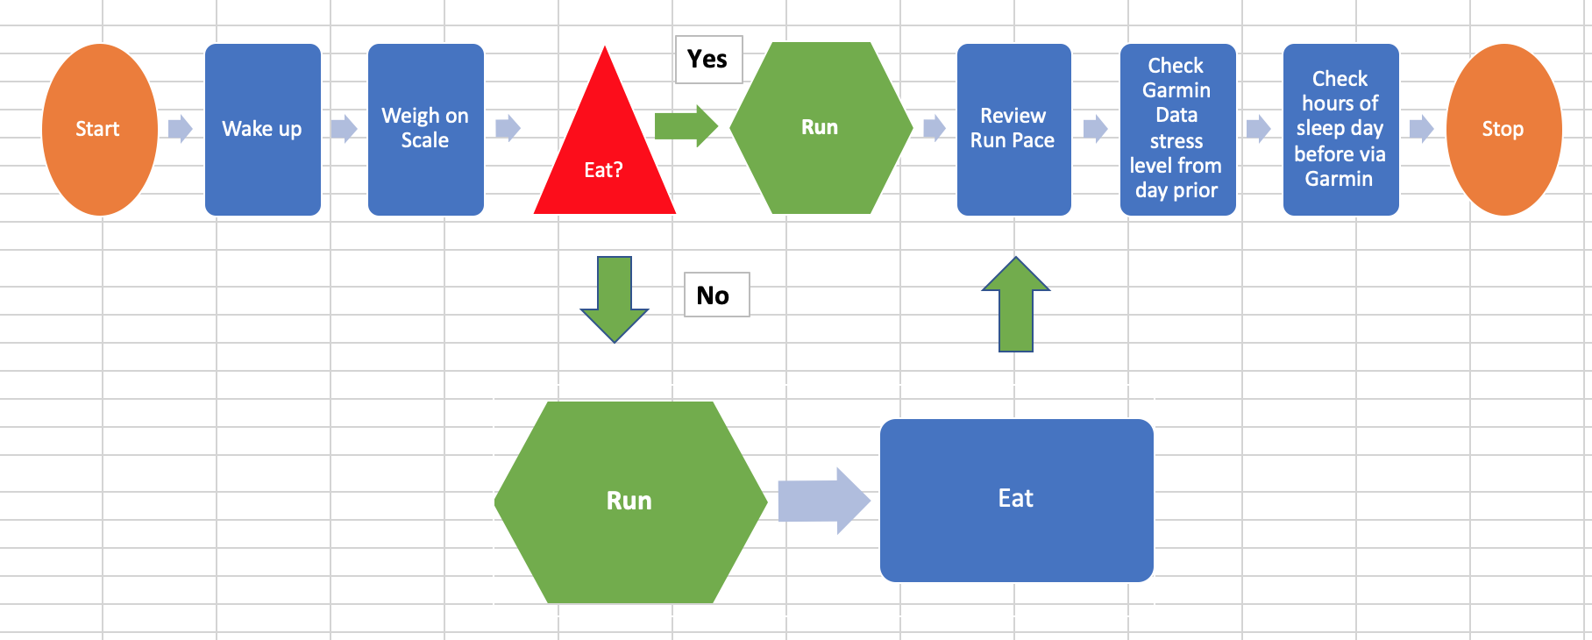
Define: Business Process
Goal: Improve running Pace
Average mile pace from 3/20/19 – 5/15/19 = 9:01/first mile (541ss)
Goal: to consistently run 8:15/first mile (495ss) or less
Further explanation on next slide
State of Running (Business) Process as of 3/20/19 – 5/15/19
Little structure or intention based around the run in terms of health with current process
Some days the runner would eat prior to running, other days he would not.
Consistent routine (except for eating), but without discipline based around hours of sleep, prior stress level, or weight
Note: Stress level is a Garmin Watch defined number on a scale from 0 – 100
Numbers are linked to nutrition, hours of sleep, and resting heart rate. May indicate dehydration.
Will speak more to this in upcoming slides
Process Map
Inputs and Outputs:
Inputs are all present, but not intentionally considered as having effect on output with this current business process.
Inputs include: Weight, Eating prior to run, Stress Level the day prior, and hours of Sleep
Output: Run (pace during first mile)

Slide 3
Define :Problem Statement
Problem Statement: The problem the runner is having is the inability to run consistently at a quick pace. He has been running consistently for 2 years with increasing distances; however, his race times have not decreased. He is currently unable to define what is not working other than investigating his current training plan. He can confirm that his race speed has not improved by observing the data that is collected on his Garmin 935 running watch. He has running data from this watch that contains running times, mile pace, stress level, hours of sleep, current weight as well as many other factors that play in to increasing race speed.
Business impact: Improving race speed by decreasing his first mile of every run to less than 8:15 pace/mile will allow him to join one of the elite running clubs in Fayetteville, Arkansas. The ability to run with the elite runners in this town will help introduce him to new people that share his interest in running. Furthermore, being included in the elite running club will help improve his running performance and improve his quality of life. He will also be eligible to receive offers on discounts for shoes at the local running store Rush Running Company through club membership. This 20% discount on shoes and apparel would roughly save him $150/year on costly running shoes and apparel.
Measure of Success: Success will be measured by consistently running 8:15pace/mile (495 seconds) or less on the final 12 runs (samples) taken. This measure of time is continuous data.
The current baseline is a pace of 540.64 seconds or 9:01pace/mile. This is based on 25 previous sample runs
Success will be to decrease the current baseline by 46 seconds over the course of the final 12 run samples.
SQL calculation on next slide

Slide 4

Current Sigma Quality Level Calculations
Opportunities: 25
Based on 25 previously recorded runs
Number of Defects per opportunity: D = 1
Based on either running less than 8:15pace/mile or not
Total possible defects for 25 opportunities: DU = 25
Actual Defects per 25 opportunities: A = 22
Only ran less than 8:15pace/mile for 3/25 runs
Defect Per Opportunity Rate: A / DU = DPO = 22/25 = 88%
Defects Per Million opportunities (DPMO) = DPO x 1,000,000
= 880,000
Current SQL Value (based on table) = 0.3

Slide 5
Measure :Data Measurement Plan
Performance Measure | Type of Data | Data Source and Location | How Will Data Be Collected | Who Will Collect Data | When Will Data Be Collected (Analysis) | When Will Data Be Collected (Improvement) | Target Sample Size
Mile Pace | Continuous | Garmin watch data | Pull from Garmin watch data site | Waylon/Garmin Watch | Analysis 3/20/19 – 5/15/19 | Improvement 5/17/19 – 6/6/19 | 12
Hours of Sleep attained the prior night | Continuous | Garmin watch data | Pull from Garmin watch data site | Waylon/Garmin Watch | Analysis 3/20/19 – 5/15/19 | Improvement 5/17/19 – 6/6/19 | 12
Garmin Calculated Stress score | Continuous | Garmin watch data | Pull from Garmin watch data site | Waylon/Garmin Watch | Analysis 3/20/19 – 5/15/19 | Improvement 5/17/19 – 6/6/19 | 12
Food Intake prior to run | Discrete | Running Journal | Written down in running journal | Waylon/Garmin Watch | Analysis 3/20/19 – 5/15/19 | Improvement 5/17/19 – 6/6/19 | 12
Body Weight prior to run | Continuous | Running Journal/Garmin watch data | Weigh prior to run | Waylon/Garmin Watch | Analysis 3/20/19 – 5/15/19 | Improvement 5/17/19 – 6/6/19 | 12

Slide 6
Measure: Detailed Collection of Data
Mile pace:
Collected by Garmin watch during the run and stored on the Garmin Connect mobile app on the iPhone. This number will be recorded into an Excel Spreadsheet after the run. In order to ensure accuracy within Excel, this number will be converted from minutes/seconds to only seconds.
Hours of Sleep:
Collected by Garmin watch during the night. This number will be stored in the Garmin Connect mobile app on the iPhone and then recorded into an Excel Spreadsheet each day before the run. This number will be recorded in minutes for accuracy within Excel.
Garmin Stress Score:
Collected by Garmin watch throughout the day. This will be collected and stored in the Garmin Connect mobile app on the iPhone and will be viewed/recorded into an Excel Spreadsheet each day before the run. This value is recorded by Garmin as numeric on a scale from 0-100 and will also be recorded as numeric in the Excel Spreadsheet.
Food Intake Prior to Run:
This has been collected in my running journal/notebook with data collection starting since January. This information will be taken from the hand-written notebook and transferred to an Excel Spreadsheet. Further recordings will be continued in the Excel Spreadsheet to reduce redundancy of data collection. This will be recorded as a Yes or No value and intake required for “Yes” is limited to 1 apple, 1 banana, or 1 cup of applesauce prior to the run.
Body Weight Prior to Run
Body weight will be taken each day prior to running on the same scale in the master bathroom. Weight will be recorded in pounds. Weight can be recorded and stored into the Garmin Connect app. Weights will be transferred from the Garmin Connect app to an Excel spreadsheet each day before the run.

Slide 7
Measure: Sample Size Calculation
Rationale for sample taken
12 samples were the minimum for at 95% confidence level
While 12 was calculated for the minimum, I had access to more samples; therefore, I used 25 samples between 3/20/19 and 5/15/19 in order to increase the accuracy of the results
12 samples were used from 5/17/19 – 6/6/19 to test for improvement
Margin of error is set at 20 seconds, my goal was to improve first mile running pace to anything less than 8:15pace/mile, and I believe a 20 second margin of error will still allow for proper analysis of results
Formula:
((1.96 * 44.1256539) / 20) ^ 2 = 11.9 or 12 samples
Measurement error is possible with the use of the Garmin
Error can occur with the “Stress Level” reading from Garmin if the watch is not worn continuously
Error can also occur in the “Sleep” input if the watch is not worn while sleeping
Error could also occur by failing to record “Eating” prior to running in Excel Spreadsheet
Ways to minimize error
Wear the watch all of the time
Leave running shoes on top of computer for “reminder prompt” to record eating status
Sample Size Calculation
95% Confidence Level | Z* = 1.96
Standard Deviation Pace(seconds) | 44.1256
Margin of Error | 20 (seconds)
Equation | ( (1.96 * 44.1256) / 20) ^2 = 11.9 or 12 samples

Slide 8
Analyze: Looking for Causality
Histogram to review current running status
25 samples from 3/20 – 5/15
Normal distribution with long left sided tale
Measures of Central Tendency (in seconds) among 25 samples 3/20 – 5/15
Mean: 540.64 seconds
Median: 550 seconds
Mode: 552 seconds
Measures of Variance
Minimum: 442 seconds
Maximum: 662 seconds
Range = 622 seconds – 442 seconds
= 180 seconds
Standard Deviation: 44.12565 seconds

Slide 9
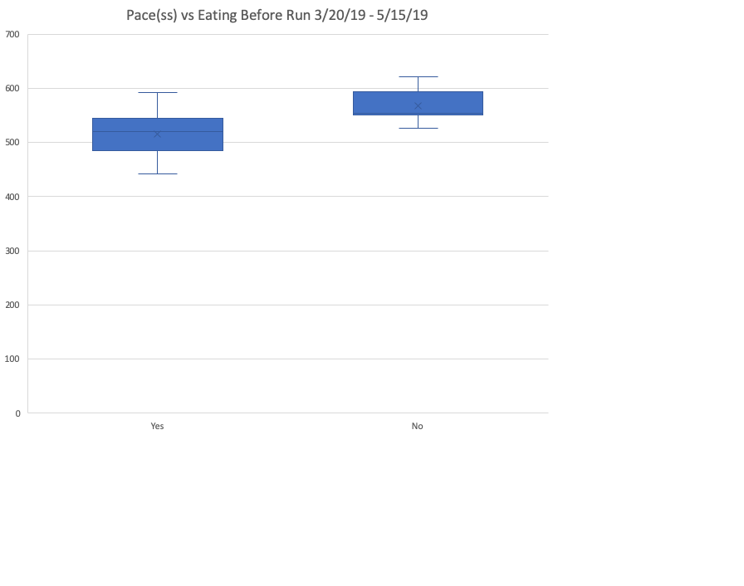
Analyze: Box + Whisker Plot
Using a box and whisker plot, we are able to see that eating before a run appears to be beneficial to improving pace
Eating was limited to an apple, banana, or cup of applesauce
Running without eating was done after 8+ hours of fasting
Box Plot Analysis
“Yes” Category
Min. :442 seconds
1st Qu.:486 seconds
Median :520 seconds
Mean :516 seconds
3rd Qu.:537 seconds
Max. :592 seconds
Box Plot Analysis
“No” Category
Min. :526.0 seconds
1st Qu.:551.5 seconds
Median :553.5 seconds
Mean :567.3 seconds
3rd Qu.:592.8 seconds
Max. :622.0 seconds

Slide 10
Analyze: Simple Linear Regression
We can see that the p-vale is larger than the set alpha of 0.05 in terms of sleep.
We do not have enough evidence at this time to support minutes of sleep being a strong contributing factor to pace with this current sample
With p-value greater than 0.05 for body weight and pace, we do not have enough evidence to support weight effecting pace at this time with this sample.
 | P-value
Intercept | 4.2954E-10
X Variable 1 | 0.18260275
 | P-value
Intercept | 6.6405E-22
X Variable 1 | 0.35970162

Slide 11
Analyze: Linear Regression (cont.) +
Correlation Coefficient
Calculated Correlation Coefficient of Stress Level vs Pace
Correlation Coefficient
0.445867179
 | P-value
Intercept | 0.17464254
X Variable 1 | 0.02549113
Simple Linear Regression of Stress Level vs Pace
While the correlation coefficient is not the preferred +/- 0.7, it is still showing a positive correlation between 0 and 1. This was this highest value of all other inputs studied in terms of effect on pace
Stress Day Before
Min. : 9.00
1st Qu.:15.00
Median :19.00
Mean :22.12
3rd Qu.:30.00
Max. :43.00
The scatterplot above reveals some correlation between Stress Level and Pace time with p-value of 0.02 being slightly less than alpha set at 0.05
Looking at the quartiles and mean of stress, it may be beneficial to keep levels below 15 for success

Slide 12
Analysis Take Away
Box Plot Analysis
Yes Food Category
Min. :442 seconds
1st Qu.:486 seconds
Median :520 seconds
Mean :516 seconds
3rd Qu.:537 seconds
Max. :592 seconds
Box Plot Analysis
No Food Category
Min. :526.0 seconds
1st Qu.:551.5 seconds
Median :553.5 seconds
Mean :567.3 seconds
3rd Qu.:592.8 seconds
Max. :622.0 seconds
Stress and Eating were two inputs that showed some evidence towards effects on Pace. Using the analysis, a new process map was created with new parameters (as seen on next slide):
Stress levels should be kept below 15 per 1st quartile of sample data
Drink plenty of water, abstain from alcohol and other dehydrants
Food should be eaten before going on the run as seen from the mean between eating before or not is 51 seconds
Stress Day Before
Min. : 9.00 stress level
1st Qu.:15.00 stress level
Median :19.00 stress level
Mean :22.12 stress level
3rd Qu.:30.00 stress level
Max. :43.00 stress level

Slide 13
Improve: Updated Process Map
New Process Map places heavy consideration on Eating and Stress levels prior to run. Garmin states that stress levels are measured by a number of factors including sleep, nutrition, hydration, and resting heart rate. I have decided to work to decrease resting heart rate by ensuring proper hydration before a run if the stress level is greater than 15. This process began on 5/17/19
15 was chosen because it was the value listed for the 1st quartile of initial data

Slide 14
Improve: Looking at the new process data
Measures of Variability after Improvement Process:
Mean =497 seconds
Median = 491 seconds
Mode = N/A
Mean only 2 seconds away from goal of 495 seconds or less!
New SQL value = 1.7
5/12 = 0.41 * 1,000,000
= 416,666 or 1.7 SQL
SQL Level moved from 0.3 to 1.7!
The line signifies when the new process was implemented

Slide 15
Improve: Time Series -Moving Average
Our moving average forecast along with the actual shows that improvement was reached simply by eating before running as well as monitoring/reducing Garmin valued stress levels through rest and hydration.
K was set at 3 to take 3 consecutive runs into account for forecasting. The green line signifies when the new improvement process was put into place (5/17/19). Conclusion: Food and Stress played strong role in slow pace

Slide 16
Control
Things to remember to maintain improvement are simple:
Eating small before run increased speed
Monitor Stress Level produced by Garmin and act accordingly (keep less than 15)
Next Round of Improvements:
Discover patterns in pace and time of day (morning/afternoon running)
Analyze effects of speed training with weekly round of running and pace times

